Slide 1
Module 1
ERM in Universities, at LEGO Group, and United Grain Growers

Slide 2
Chapter 5
ERM in Practice at the University of California Health System

Slide 3
  UC began ERM starting in 2004 – pg 75
    CRO hired and ERM panel created to implement system wide
  Key Performance Indicators (KPI) – Pg 76-77
    Critical success factors and key goals of an organization
    Main areas of focus in order to achieve strategies of organizational goals
    Updating can be daily, weekly, monthly, or quarterly
    Improvement is measured through historical or budgetary numerics
    Can be generated through all layers of the organization
  ERM Information System (ERMIS) – internally generated to assist decision processing of risk
    Ability of democratizing information with the ability to provide key data and reports to personnel at all levels and locations – full transparency of data
    Dashboard reporting on major areas of risk
    Control and accountability tracking platform
    Risk mitigation and monitoring tools
    Survey capabilities
    Produces
      Better quantitative analysis capabilities
      Improved analytical and reporting capabilities
      Support for leading risk governance and compliance processes
      Systemwide visibility
      Scalability without additional burden on UC staff

Slide 4
ERM system integration at UC – pg 80
  Each medical center uses a web-based clinical incident reporting system that permits any staff member to report an event or near miss
  Each of the UC medical centers has individuals (category managers) who are responsible for the monitoring and evaluation of certain types of events and taking action on them
  Trend reports are prepared for facility patient safety and quality committees and forwarded through the facility committee structure to the facility governing body
  Adverse event incidents are monitored, and serious events that may require reporting to the state are reviewed weekly
  Medical centers measure and review data on a number of metrics from patient complaints to infection rates, patient falls, etc.…
  Hospital-level data is compared with national benchmarks and internal data
Professional Liability Prescription Program (PLPP)
  Initiative to encourage risk reduction to reduce the cost of risk for the hospitals and schools of medicine
  It puts loss control in the hands of individuals responsible for the outcomes

Slide 5
  Protected Health Information Value Estimator (PHIve)
    Applies a practical methodology for protected personal health information to calculate potential (actual) cost of a data breach to their organization
    Assist to determine a possible impact of a PHI breach to mitigate possible failures
    Five steps
      Assess risks, vulnerabilities, and applicable safeguards for each PHI home
      Security readiness score calculation
      Relevance by location of a particular cost category
      Determine potential repercussions by location and in total
      Determine total of data breach by location and as total for the organization
    Additional information to review
      Reputational repercussions
      Financial repercussions
      Legal and regulatory repercussions
      Operational repercussions
      Clinical repercussions

Slide 6

ERM at University of California Health Care
https://www.bing.com/videos/search?q=ERM+in+University+of+California+Health+System&&view=detail&mid=EF32F935062E66AC4AD0EF32F935062E66AC4AD0&FORM=VRDGAR

Slide 7
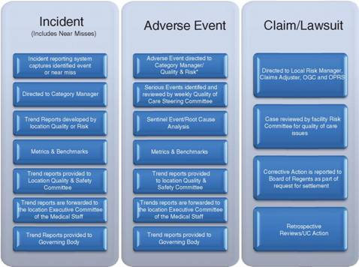
UC’s Enterprise Risk Management Approach to the Evaluation of Incidents, Events, and Claims
https://www.bing.com/images/search?view=detailV2&ccid=qHFjJ2xj&id=2248F368E223FE86B738D48E84CF24D1B3E977D2&thid=OIP.qHFjJ2xj7y34I7-aB_FmpAEsDf&mediaurl=http%3a%2f%2facademlib.com%2fimag%2fmanag%2ffras_imperm%2fimage015.jpg&exph=356&expw=478&q=uc+enterprise+risk+management&simid=608016123784267626&selectedIndex=12&ajaxhist=0

Slide 8
Chapter 6
Strategic Risk Management at the LEGO Group: Integrating Strategy and Risk Management

Slide 9
  LEGO Strategic Risk Management four step development – pg 95
    Enterprise risk management eventual installation of strategic risks
    Monte Carlo simulations added in 2008 to understand the financial performance volatility
      Eventually integrate into the budgeting and financial reporting processes
    Active risk and opportunity planning (AROP) where business projects go through a systematic risk and opportunity processes as part of preparing the business case before final decisions about projects are made
    Preparing for uncertainty, where management tries to ensure that long-term strategies are relevant for and resilient to future changes that may very well differ from those planned for
    The four steps allow a realistic goal oriented total integration into company wide systems over time
  Enterprise Risk Management – Step 1
    Initially, risk management was embedded within processes but never incorporated larger strategic risk management thought within them.
    The CFO, Hans Laessae, started the program to include in one large umbrella operational risk, employee healthy and safety, information technology security, financial risk, legal risk into one system along with adding the most important global corporate strategic risk
    Corporate Executive Board findings
      Strategic risk caused 68% of sever market capitalization declines as they have the greatest negative impact on enterprise value
    Key components of this step includes an executive with a broad knowledge of the business, it’s core strategies. Further expertise with strong internal and external stakeholder acceptance and full backing of the CEO and board

Slide 10
  Monte Carlo Simulation – 3 area integration for ERM at LEGO Group
    Budget simulation – business controllers part of process of past historical performance and anticipated knowledge of future performance allowed a broader range of outcomes and eventually lead to a sales volatility recognition for top management
    Credit risk portfolio – Used similar approach to gain a deep knowledge of customer stakeholder credit risk
    Consolidation of risk exposure – A 3% worst case scenario loss compared to budget calculation to use to define the organizations risk appetite and risk report exposure.
      It is important to understand that risk management is not about averages, but about focusing on the loss and what occurs from the loss in terms of financial stability, reputational loss, etc...
  Risk Tolerance
    Stock values are not a good indicator to use for risk and thus, the amount of earnings a company is likely to loose is the best way to compare risk tolerance.
    LEGO Group computes a net earnings at risk (EaR) as a key risk tolerance indicator
    The EaR is reviewed by corporate management and the board of directors to finalize their decision on organizational risk tolerance. Currently they use 3% worst-case loss from anticipated net earnings
  Active Risk Assessment of Business Projects (AROP)
    Business projects as a specific size all must include explicit definitions and methods of handling risks and opportunities within the business plan of the project
    Spreadsheet tool to analyze the following for AROP
      Identification – look at risks both to the project and from the project
      Assessment – define explicit scales and agree what “high” means
      Handling – Use of early warning indicators (dashboard approach)
      Reassessment – define the net risk exposure
      Follow-up – project updated for gate and milestone sessions
      Reporting – automated and standardized within the IT system

Slide 11
  Park, Adapt, Prepare, Act Model (PAPA)
    Park – slow things have the low priority of happening are parked for later consideration
    Adapt – slow things that will or likely will happen are adopted in trending scenarios
    Prepare – low probability of occurring and materialize fast must be inclusive and part of the preparedness plans
    Act – high probability and fast moving are needed to be acted on immediately and take top priority

Slide 12

LEGO Group Strategy for Ethics, Risk, and Sustainability
https://www.bing.com/videos/search?q=Lego+group+risk+management&&view=detail&mid=93747D44CA3F3A9C4CF193747D44CA3F3A9C4CF1&FORM=VRDGAR

Slide 13
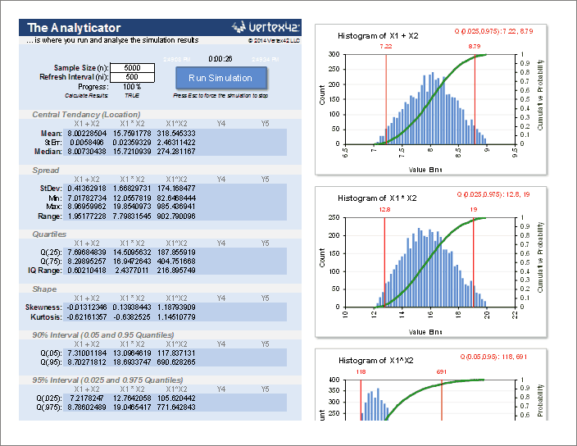
Monte Carlo Simulation Example
https://www.bing.com/images/search?view=detailV2&ccid=9fjIM%2fAx&id=8FD9A26BD195E8D4B2404F266B040A2C99824C7C&thid=OIP.9fjIM_Ax_OpRZl_S8qmt9gEsDn&mediaurl=http%3a%2f%2fcdn.vertex42.com%2fExcelTemplates%2fImages%2fmonte-carlo-simulation-template-for-excel.png&exph=544&expw=704&q=monte+carlo+simulation+examples&simid=608054847172709343&selectedIndex=2&ajaxhist=0

Slide 14
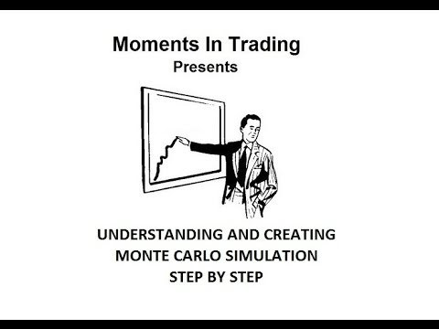
Monte Carlo Basics
https://www.bing.com/videos/search?q=monte+carlo+erm+explanation&&view=detail&mid=B101142464193B02E9E3B101142464193B02E9E3&FORM=VRDGAR

Slide 15
Chapter 7
Turning the Organizational Pyramid Upside Down: Ten Years of Evolution in enterprise Risk Management at United Grain Growers

Slide 16
  United Grain Growers – ERM pioneers – pg 107-110
    Started risk financing program
    Harvard case study and CFO magazine hailed program as “deal of the decade”
    CEO 2 strategic objectives
      Razor sharp focus on improving financial performance of the company
      Financial performance improved to attract long-term shareholders
    Risk management had been a major component ingrained in the company since the 1970’s
    Mature organization entrenched in bureaucratic business model
  Grain business risk background – pg 109-110
    Capital intensive
    Supply and commodity risks are high due to exchange rates and variable crop yields
    Regulatory and trade risks
    Weather
    Overall grain production volume risk were the main drivers of revenues and profits
    Rising costs of infrastructure causing upward pressure on working capital requirements
  UGC Cost of Risk – pg 110
    Cost of risk = net risk retention costs + risk transfer costs + risk-related administration overhead

Slide 17
ERM Credit Financing Outcomes – pg 113
  Applied ERM to new business product financing
  Opened up extended credit for farmer customers
  Strategic alliance between UCG and Scotiabank
  Results amounted to freeing up $200M in Free Cashflows
  Moved success to the livestock division also
  All reliant on the quantitative intelligence that provided a high degree of accuracy to achieve return targets without excessive risk
Agricore United – pg 115
  Application of enterprise wide risk management to outside internal products and into mergers and acquisitions
  Ability of the ERM program to gain further access to receivables would have led to up to $300M in free cash flows and reduced financing from their balance sheet

Slide 18
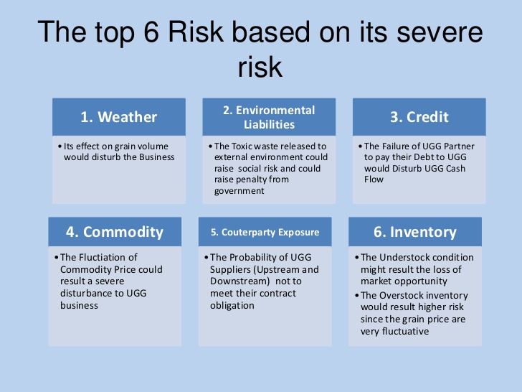
UGG Risk Severity Scale
https://www.bing.com/images/search?view=detailV2&ccid=aFbM9933&id=97E329DF54A53310C2EB632E2B09E071D3DEA2B9&thid=OIP.aFbM99332bwGE3FVSJ7njgEgDY&mediaurl=https%3a%2f%2fimage.slidesharecdn.com%2funitedgraingrowers-120324015006-phpapp02%2f95%2funited-grain-growers-26-728.jpg%3fcb%3d1332553872&exph=546&expw=728&q=united+grain+growers+enterprise+risk+management+system&simid=608052334629291177&selectedIndex=7&ajaxhist=0

Slide 19
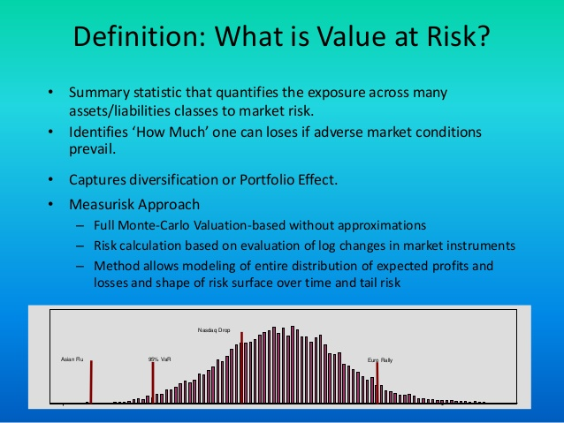
Value of Risk
https://www.bing.com/images/search?view=detailV2&ccid=mBvXiNkK&id=97E329DF54A53310C2EB2FB76526A7F86FC451AB&thid=OIP.mBvXiNkKKV4bN8aRryEMogEgDY&mediaurl=https%3a%2f%2fimage.slidesharecdn.com%2funitedgraingrowers-120324015006-phpapp02%2f95%2funited-grain-growers-25-638.jpg%3fcb%3d1506690749&exph=479&expw=638&q=united+grain+growers+enterprise+risk+management+system&simid=607988258024522114&selectedIndex=5&ajaxhist=0

